Slide 1
Protocols and Network Devices
Networks 101 Day 3

Slide 2
Today’s Objectives
By the end of class, you will be able to:
Use Syn Scans to identify suspicious patterns of activity
Analyze Wireshark packets to identify the ports and protocols being used.
Use the ARP protocol to identify the MAC address associated with a given IP address.
List common network devices and their functions.
List common network topologies and their advantages and disadvantages.
Use traceroute to show the route over the network between two systems.

Slide 3

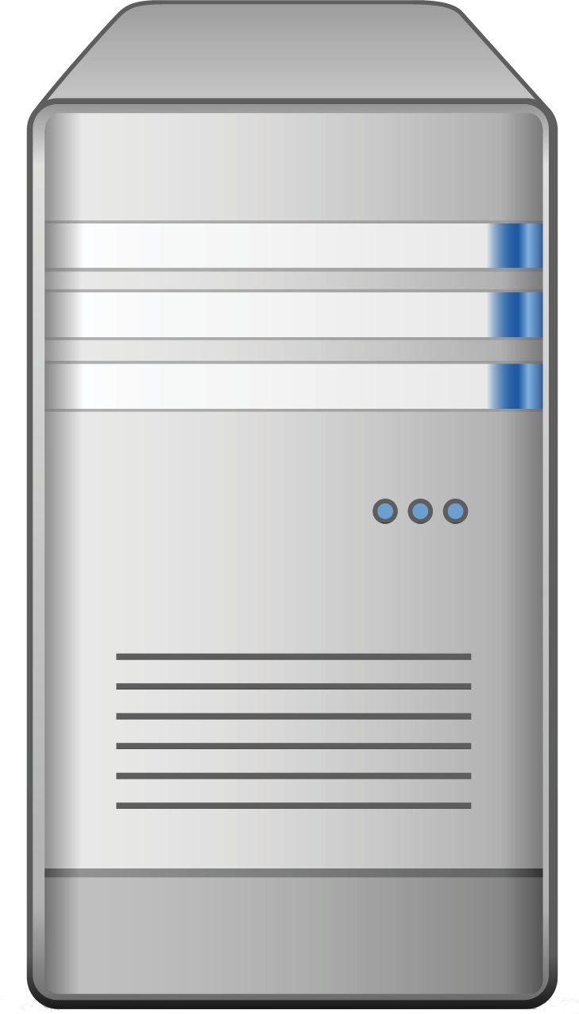
TCP Handshake Review
Connection-Oriented, 3-way handshake, 4-way close
Setup: SYN, SYN-ACK, ACK
Teardown: FIN, ACK, FIN, ACK
FIN
SYN
ACK
SYN-ACK
FIN
ACK
ACK
Data

Slide 4
Activity: Syn Scan
In this activity, you will analyze a capture that contains a series of SYN packets sent to a set of potentially open ports on a target device.
Instructions sent via Slack.
15 Minutes

Slide 5
Your Turn: Syn Scan
15 Minutes
Instructions:
For each of the ports 80, 443, and 113, filter the traffic by that port number and answer the following:
What protocol is associated with that port?
Who is sending the SYN packet?
Did the recipient acknowledge the request?
What does the response likely mean for whether that port is accessible and/or accepting connections? (use your knowledge of the handshake!
Open the “Conversations” window (Statistics -> Conversations), and sort the conversations by the packets column (packet count), descending.
Based on what you see here, what other ports might be open, closed, or inaccessible? What protocols are associated with those ports?
Who seems to be doing the syn scan?

Slide 6
Syn Scan

Slide 7
Ports and Protocols

Slide 8
Ports Refresher:
How does each layer utilize ports?
The data-link layer uses MAC address to know where to send a packet.
The packet layer uses an IP address to know where to send the data packet.
The Transport layer uses ports to know where to send the data packet.
The Session layer uses ports from the transport layer to handle communications.

Slide 9
Three Port Groupings
What are the characteristics of these three ports?
0 to 1023
1024 to 49151
49152 to 65536

Slide 10
Three Port Groupings
What are the characteristics of these three ports?
0 to 1023
They are well known and well-defined port numbers, and the most common protocols are in this range.
1024 to 49151
They have been registered for specific purposes, but are not unique, meaning other people can use them.
49152 to 65536
They are for private or customized services and can’t be registered.

Slide 11
Activity: Wireshark Port Identification
In this activity, you will open up and inspect two PCAP files using mystery protocols.
Instructions sent via Slack.
10 Minutes

Slide 12
Your Turn: Wireshark Port Identification
10 Minutes
Instructions:
For each PCAP file, answer the following:
Who is the sender? What port is the sender using?
Who is the receiver? What port is the receiver using?
What protocol is being used?
Investigate and write a sentence or two about the purpose of the protocol and how it works. See if you can identify individual steps in communication associated with the protocol.

Slide 13
Wireshark Port Identification

Slide 14
Activity: ARP/MAC Addresses in Wireshark
In this activity, we will move up the OSI model to look at MAC and IP addresses.
Instructions sent via Slack.
10 Minutes

Slide 15
ARP / MAC Address in Wireshark

Slide 16
Activity: Chat Spy
In this activity, you will look at a larger pcap file associated with two users communicating in an online chat room.
Instructions sent via Slack.
15 Minutes

Slide 17
Chat Spy

Slide 19
Networks

Slide 20

Computer Networks Review
What is a Computer Network?
A computer network is a digital telecommunications network which allows nodes to share resources. In computer networks, devices exchange data with each other using connections (data links) between nodes. These data links can be over cable media (wires or optic cables) or wireless media (wifi).

Slide 21

Computer Networks Review
What is a Computer Network?
A computer network is a digital telecommunications network which allows nodes to share resources. In computer networks, devices exchange data with each other using connections (data links) between nodes. These data links can be over cable media (wires or optic cables) or wireless media (wifi).
Simply put, a computer network is a connection between two or more computers with the intention of sharing information between them.

Slide 22

Connecting Computers
Connections between computers are typified in two ways:
Physical Connection: The physical medium of wires, wireless media devices, etc.
Logical Connection: The abstract path data takes in order to arrive from point A to point B

Slide 23


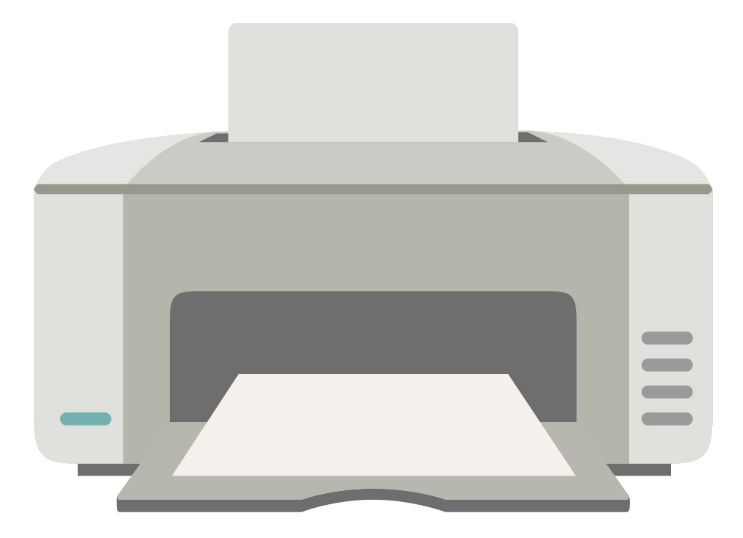
A Classic Modern Day Network
Most of us are familiar with the Small Office Home Office (SOHO) Network:
The Internet

Slide 24


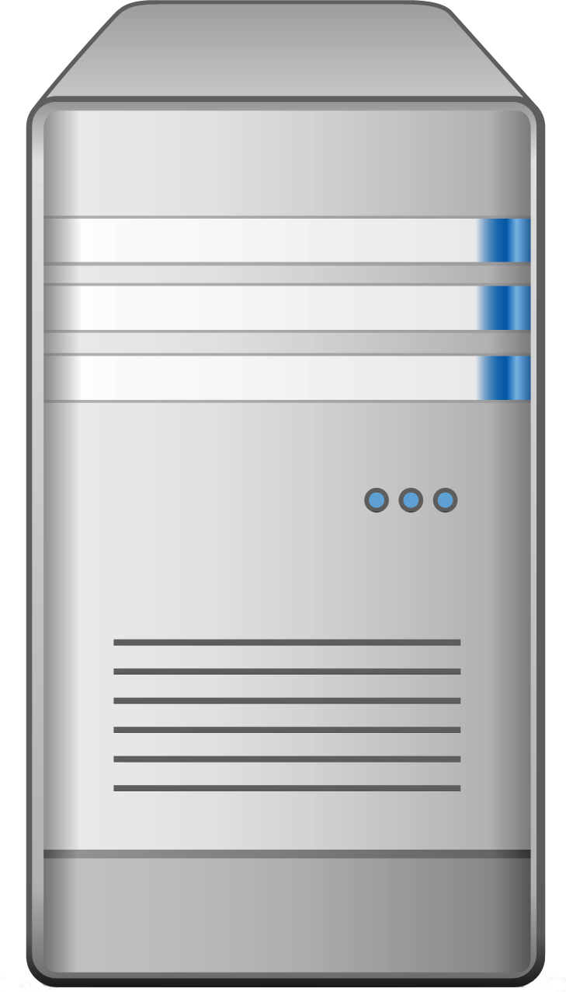
Packets and Routing
Sending Data from here to there:
Routing:
Packets are relayed across networks of routers that feed-forward information to a next closest location until they are re-assembled at the end point.
Packets:
Each request or response is broken into Tiny packages of data

Slide 25
IP Addresses and MAC Addresses: Our Digital Phone Numbers
Every device is pre-assigned a MAC address and IP Address.
These addresses provide information that other routers need to relay their data through the interconnected network.
Routers dynamically assign IP addresses to ensure no duplicates.
IP Address 151.20.0.145
MAC Address: 88:f7:c7:65:1a:36
IP Address 188.4.4.72

Slide 26
Why do computer networks exist?
(Think beyond the internet)
Centralization of Resources and Critical Data
Fast, Efficient Communication
Data Sharing
Backup and Recovery
Distribution of Computer Power

Slide 27
Networking Devices

Slide 28
Networking Devices
We may be familiar with All-In-One Network Devices, but its important to understand each device in greater nuance:
Router
Switch (and Hubs)
Bridge
Firewall
Network Interface Cards (NICs)
Wireless Access Point
Wifi Routers and Modems
Servers (HTTP, DHCP, FTP)

Slide 29
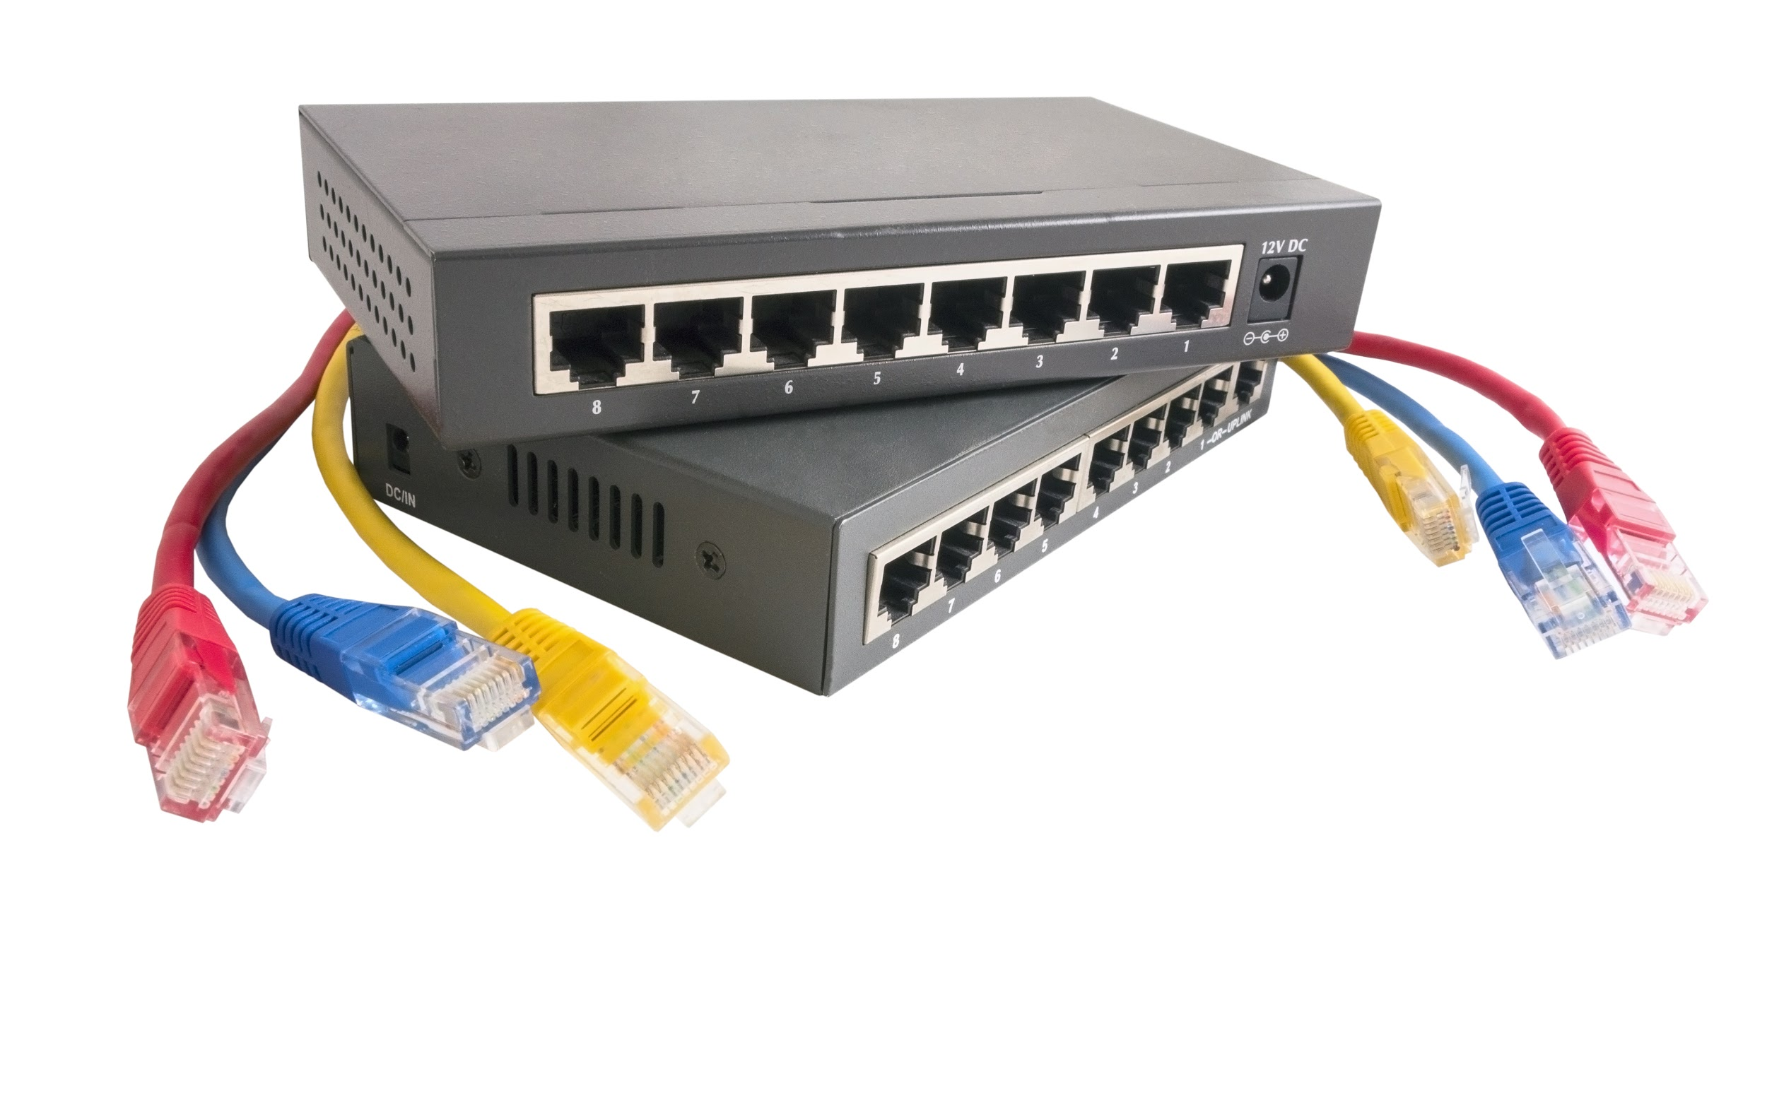
Network Devices: Routers
Networking device that forwards data packets between computer networks. Routers play the role of directing traffic through the internet.
The simplest routers forward IP packets between home computers and the web.
In enterprises, routers can play the role of chaining computer systems in internal networks.
Notes:
Shutterstock_242400463
Icon: shutterstock_348430685

Slide 30
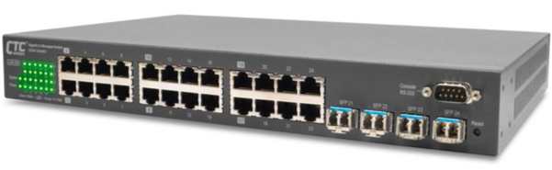
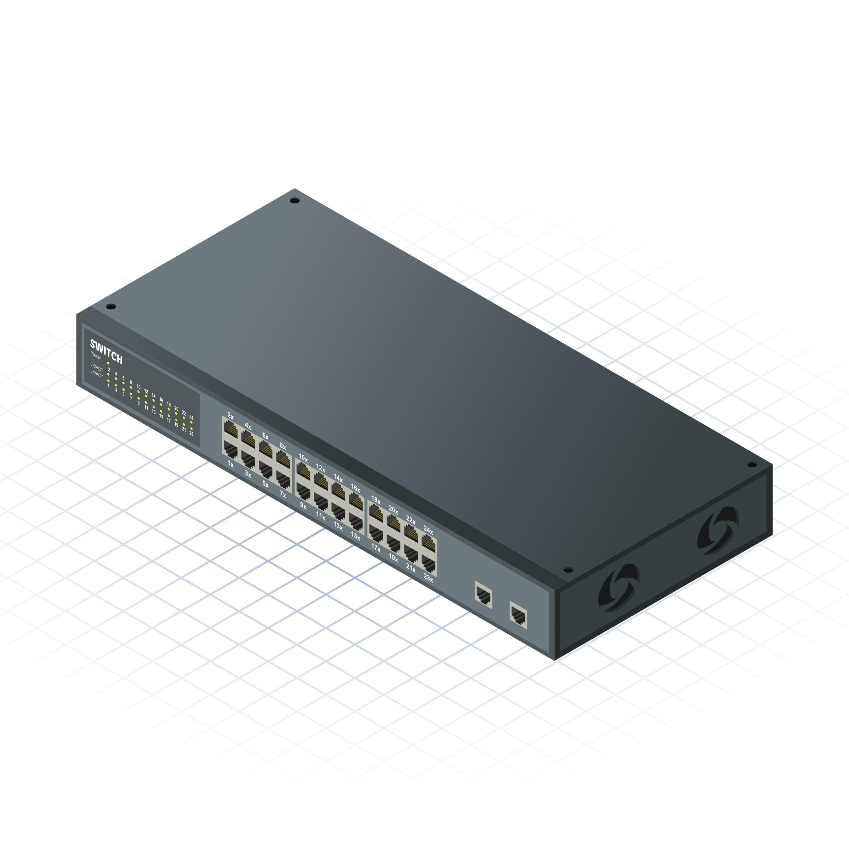

Network Devices: Switches
Network Switches connect multiple devices together. They distinguish between each device and serve as a central control.
Switches seem similar to routers, but are very different.
Switches create networks, while routers connect networks.
Typically you will see switches feed into routers.
Notes:
Iso: shutterstock_231329284
Icon: shutterstock_348430685
CTC branch low risk

Slide 31
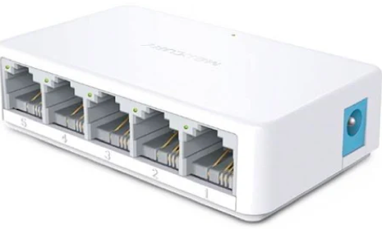
Network Devices: Hubs (Dated)
Hubs are an older version of switches. They server as a common connection point for devices, but unlike switches, they cannot differentiate between each device. Instead they rely on broadcasting communication to all devices.
Hubs are inherently less secure than switches because data from each device is communicated to all other devices.
Notes:
Low-Risk

Slide 32
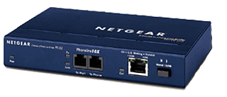

Network Devices: Bridge
Bridges are effectively switched but with only two ports available.
Bridges are often used to tie two LANs together.
Notes:
Low-Risk

Slide 33
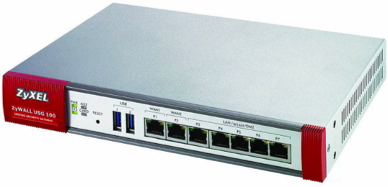
Network Devices: Firewall
Firewalls are network security systems that monitor incoming and outgoing traffic based on security rules.
Firewalls are often categorized as network firewalls and host-based firewalls.
Host-based firewalls are like software that runs on your machine.
Network-based firewalls are devices that monitor traffic in and out of network hardware.
Notes:
Low-risk ZyXEL brand

Slide 34
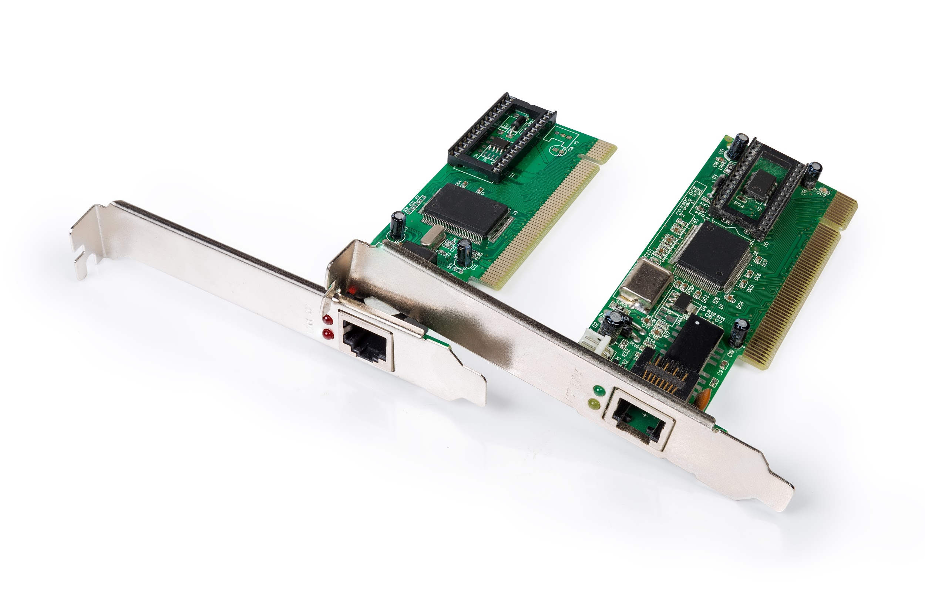
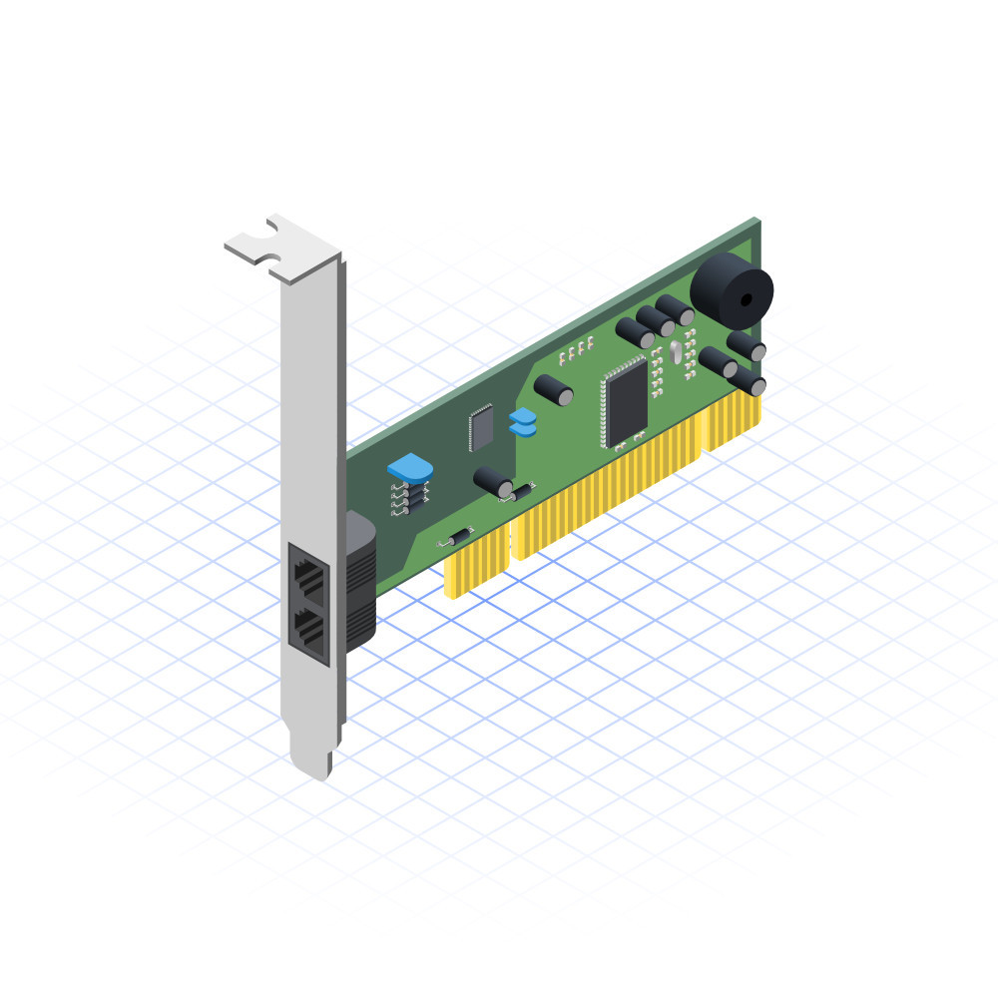
Network Devices: Network Interface Controller (NIC)
Network Interface Controllers describe computer hardware that connects a computer to a computer network. Allow computers to connect via the standard physical and data layers associated with Ethernet and Wifi.
Every NIC is assigned a MAC address, printed on the device, giving it a unique address.
Notes:
Shutterstock_1322349632
shutterstock_200530805

Slide 35
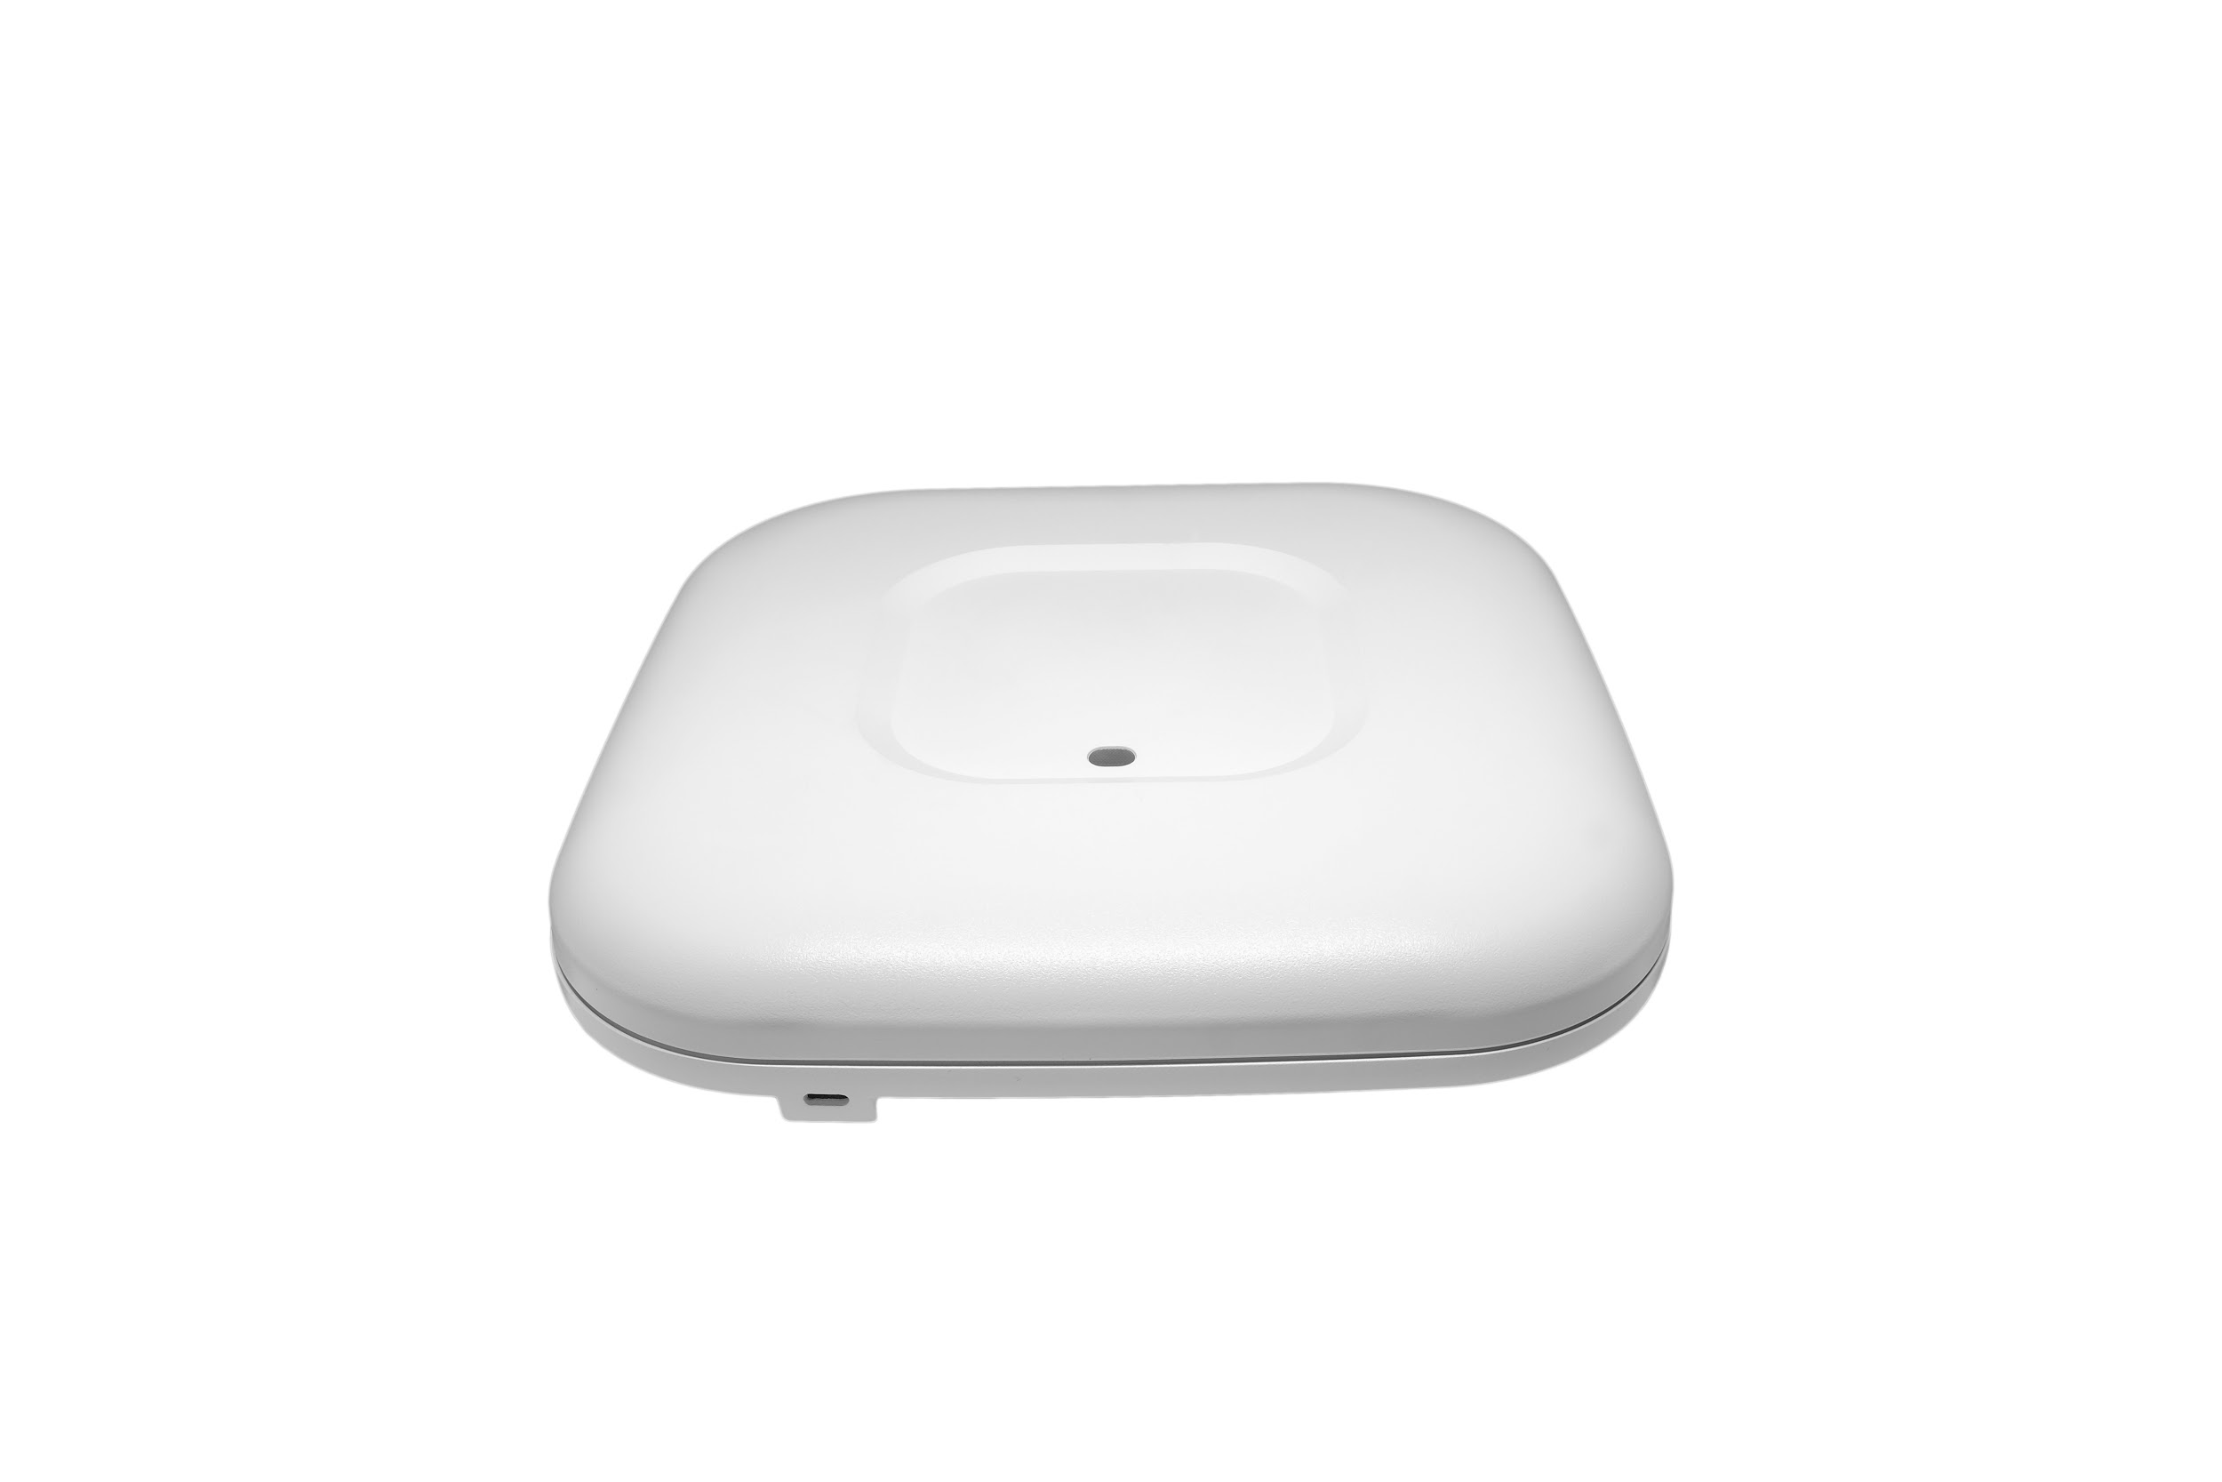

Network Devices: Wi-fi Router
A Wireless Access Point is a network hardware device that allows a Wi-fi device to connect to a wired network.
The WAP connects to a router as a standalone device the way a typical wired device might.
Increasingly, WAPs are built into routers as in the case of all-in-one devices.
Notes:
Shutterstock_626991497
shutterstock_606004955

Slide 36
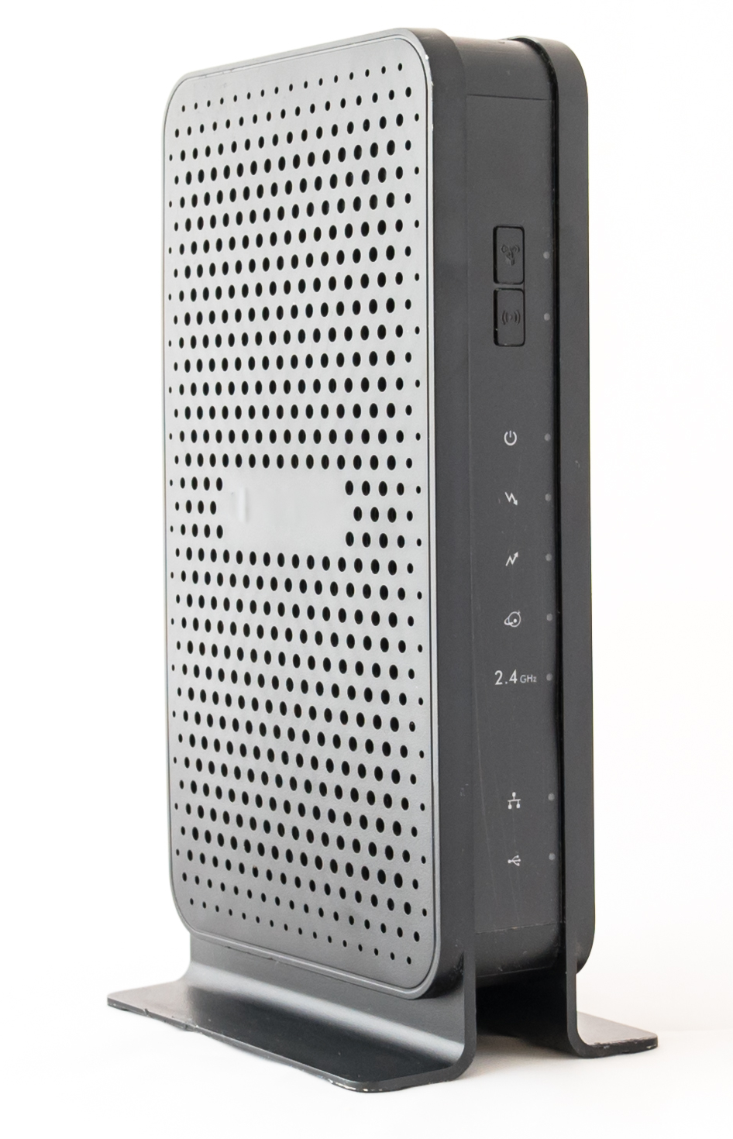
Network Devices: Modem
Modems (modulator-demodulator) are network devices that convert digital information for transmission and converts transmitted information into digital information. Can be used to convert data into light waves, electric signals, or radio signals.
The hallmark role the modem plays in to convert data into a format that can be relayed across long distance over wires, electromagnetic waves or light.
Notes:
Shutterstock 1126778270

Slide 37
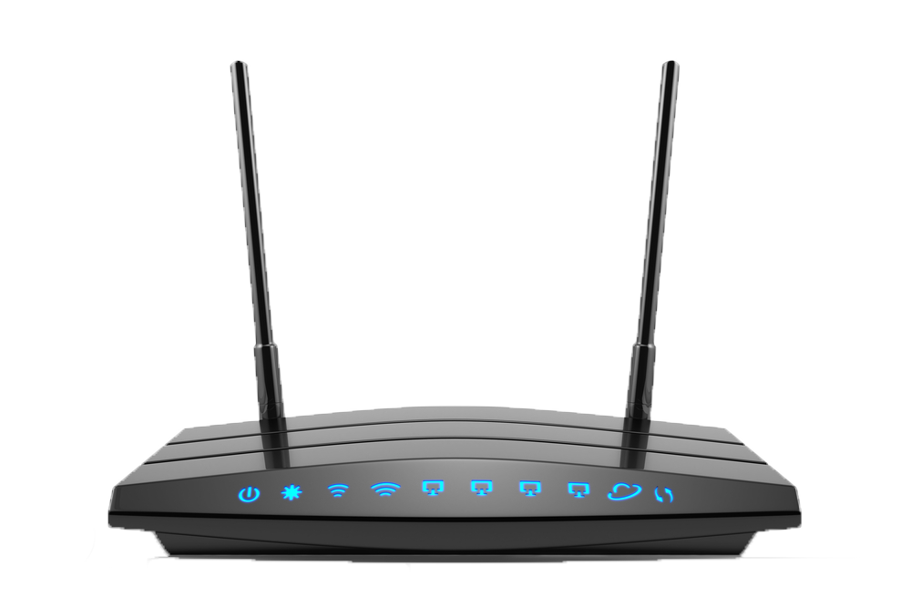
Network Devices: Wireless Router
Wireless routers combine the functionality of routers and wireless access points.
The devices often include the all-in-one capabilities of built-in Ethernet switches and modems.
Notes:
Shutterstock id: 447377149

Slide 38
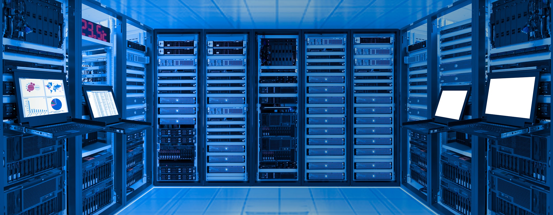
Network Devices: Servers
Servers provide functionality for other programs or devices.
Servers aren’t truly network devices.
They are more akin to the personal computers that we tie into a network.
Servers often house the data and business logic of a company and networks provide a pathway to access this data.
Notes:
shutterstock_1015502020

Slide 39
Activity: What’s that Device
In this activity, you will ask and answer the following questions about network devices with a partner.
Instructions sent via Slack.
10 Minutes

Slide 40
Your Turn: What’s that Device?
10 Minutes
Instructions:
Which device would I use to direct traffic across multiple local or wide area networks?
Which device would I use to control traffic among multiple wired devices on a single network?
What is the difference between a hub and a switch? What might be the security implications of this?
What is a network interface card for? What does it have to do with a MAC address?
What exactly is a modem? How is this different from a router?
What might be the advantages of using a single all-in-one device?
What might be the advantage of using separate devices for each function?

Slide 41
Network Devices

Slide 42
Network Topologies and Architecture

Slide 43
Network topology is the arrangement of a network and the deliberate design of those links is the network architecture.

Slide 44

Network Architecture
Notes:
Diagram re-created

Slide 45
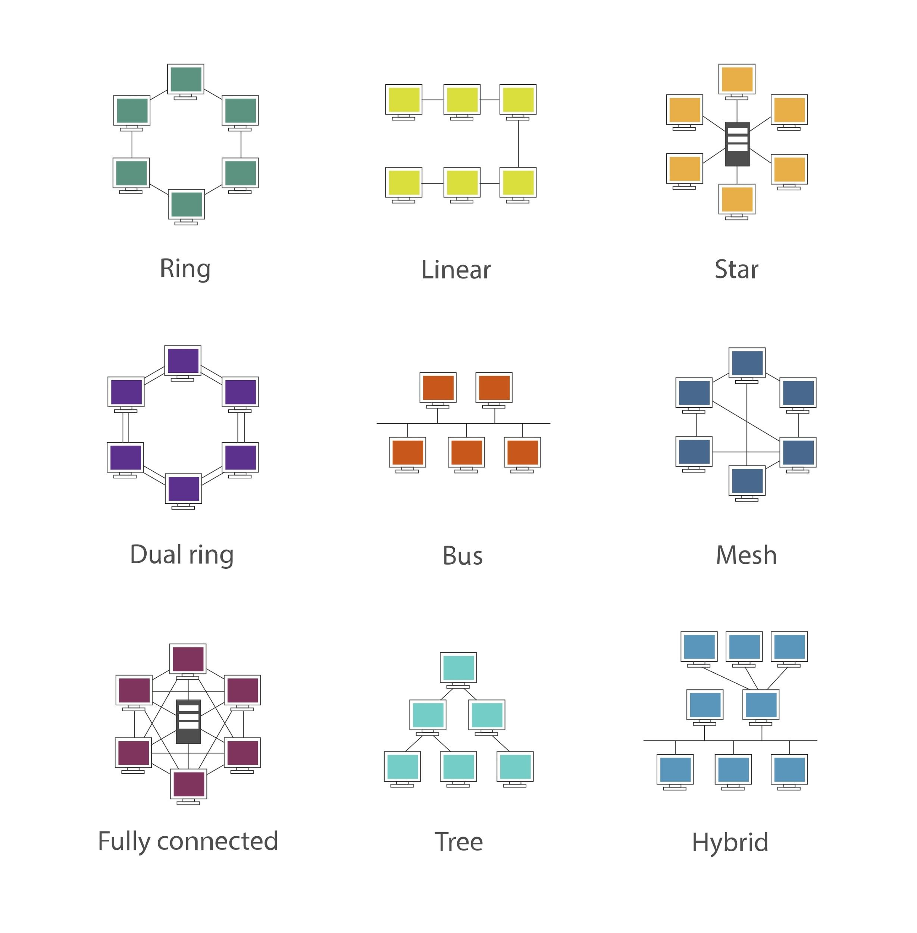
Network Topologies
Notes:
Shutterstock 321768158

Slide 46
traceroute

Slide 47
Traceroutes
Sometimes, communication between devices fail.
Network admins can use traceroute to troubleshoot networking communication issues between two devices.
Traceroute shows the route of the network between two systems, listing all the routers the connection must pass through.
Traceroute can be used to pinpoint precisely where their connectivity problems might be.
They can see if there’s a problem closer to the source device, destination device, or within the path it takes between devices.

Slide 48
Traceroutes
Some relevant terms for traceroutes:
Internet Control Messaging Protocols send operational information and error messages indicating a certain requested service is reachable or not available.
Datagrams are basic transfer units used in connectionless communication.
Time-to-Live (TTL) is used by IPv4 routers to prevent routing loops by discarding looping packets
ICMP Time Exceeded Message is sent by the receiving router when it receives the packet with a TTL set to 0, meaning the packet reached its time limit.

Slide 49
Traceroute
User Datagram Protocol:
A
B
C
D
ICMP Echo Request TTL = 1
1st Hop
ICMP Time Exceeded
ICMP Echo Request TTL = 2
2nd Hop
ICMP Time Exceeded
ICMP Echo Request TTL = 3
Last Hop
ICMP Time Exceeded

Slide 50
traceroute

Slide 51
Activity: Intercepting traceroute results on the command line
In this activity, you will traceroute to three domain names using either Terminal (Mac) or Git Bash (Windows)
Instructions sent via Slack.
10 Minutes

Slide 52
Your Turn: Interpreting traceroute on the Command Line
Instructions
In this activity, you will traceroute to three domains using either Terminal (Mac) or Git Bash (Windows).
The three domains are:
centurylink.com
social-engineer.com
Pcmap.com
For each domain name perform a traceroute, and then for each answer the following questions:
Which hop took longest time?
Were any hops skipped?
Where were there dropped packets?
Did the traceroute complete?
Bonus:
To explore more on your own, try a few more domains of your choice and see if you can find anywhere the traceroute completes.

Slide 53
Traceroute

Slide 54
Activity: Visual Plotting of traceroute
In this activity, you will traceroute three non-US-based domain names, and then visualize them via Traceroute mapper.
Instructions sent via Slack.
10 Minutes

Slide 55
Visual Plotting Traceroute

Slide 56
Today’s Objectives
By the end of class, you will be able to:
Use Syn Scans to identify suspicious patterns of activity
Analyze Wireshark packets to identify the ports and protocols being used.
Use the ARP protocol to identify the MAC address associated with a given IP address.
List common network devices and their functions.
List common network topologies and their advantages and disadvantages.
Use traceroute to show the route over the network between two systems.

